Slide 1
NotMyFitnessPal
Aaron, Marcy, Nasir, Sarina, Suraaj
Notes:
A reminder of who spoke about each slide has been left on each slide’s speaker notes for reference :)

Slide 2
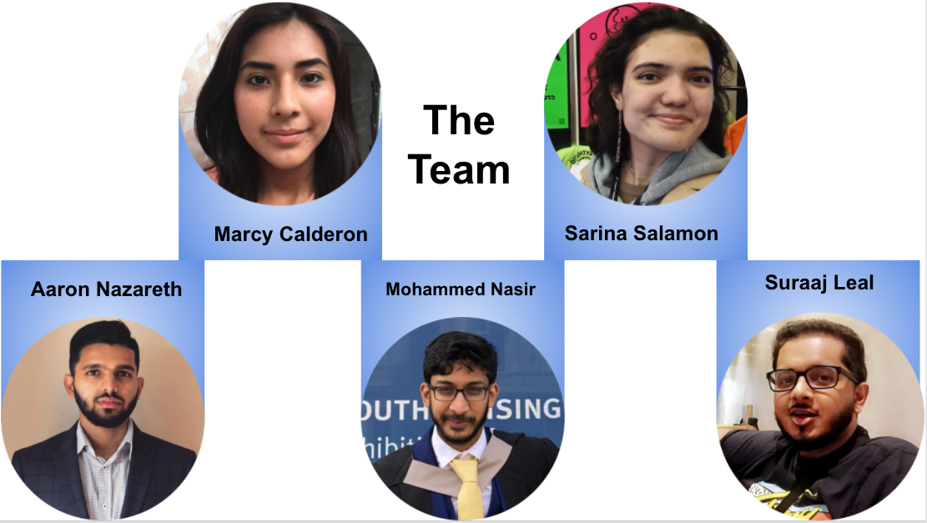
Notes:
Sarina

Slide 3

Introducing NotMyFitnessPal!
A food tracking API built using Java, SQL, Spring Boot
Get stored food from a database
Update stored food items
Delete food items
Able to select food by…
Person_id
Week and day
Meal type
Notes:
Sarina

Slide 4
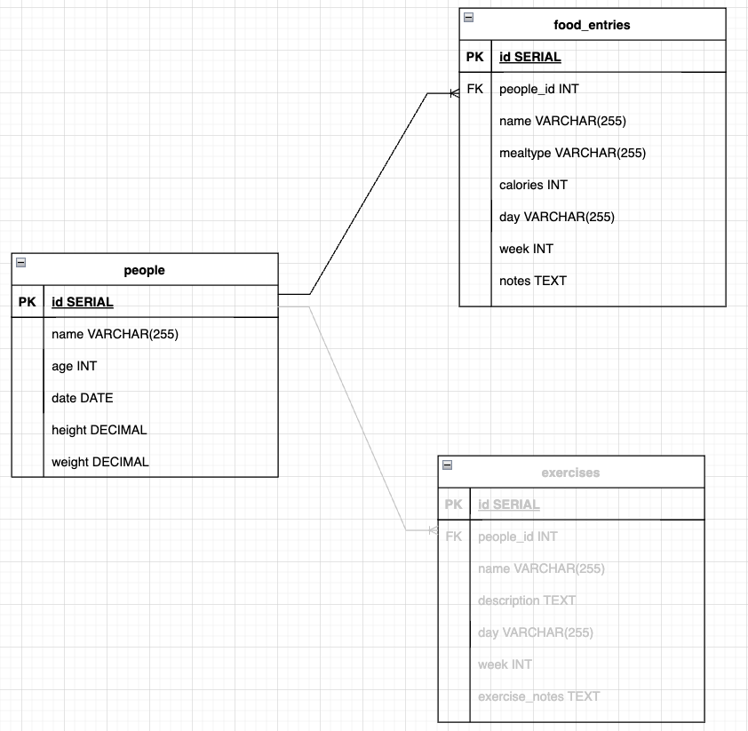
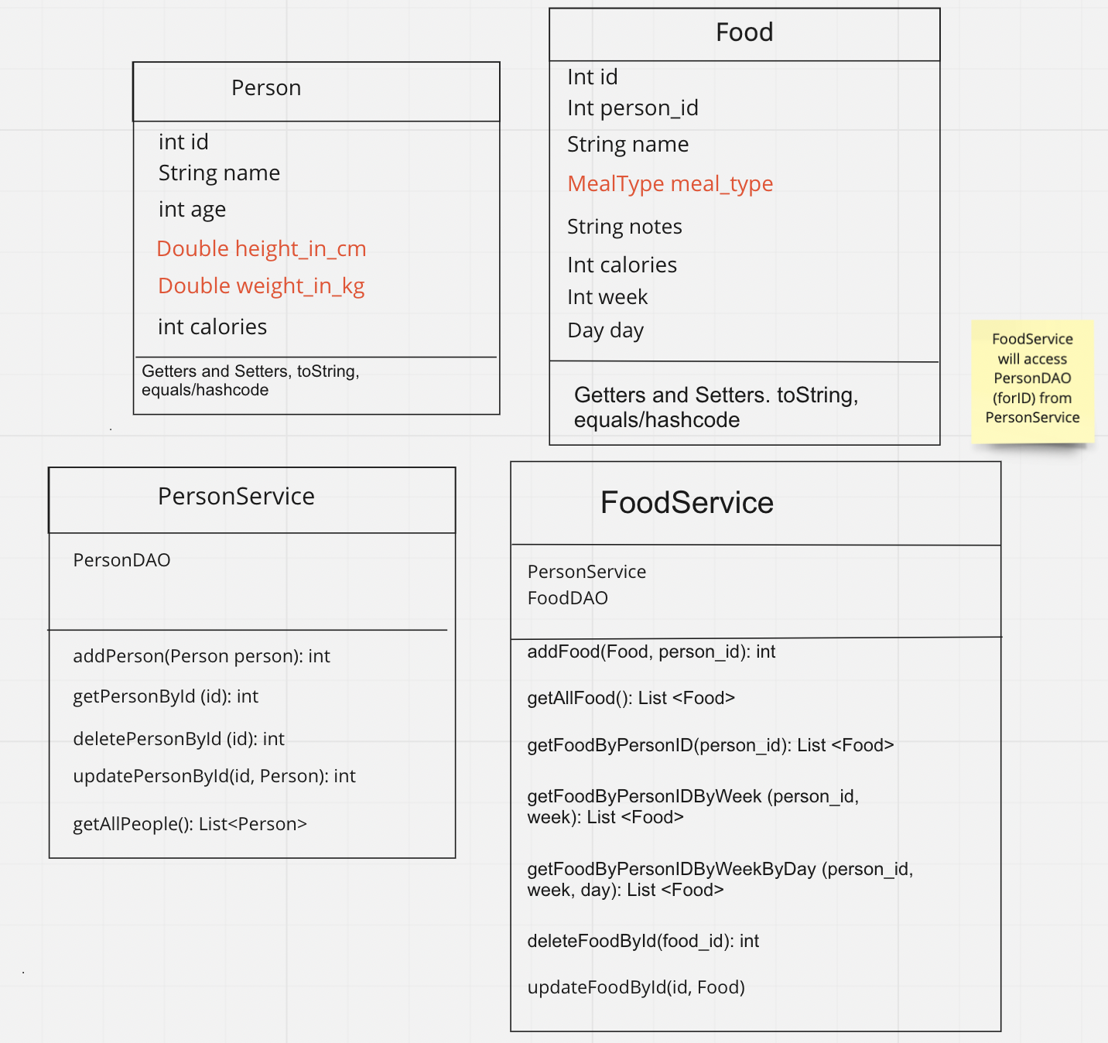
Planning - ERD, Class Diagram
Friday - POJOs, services, methods, ERD
Notes:
Nasir

Slide 5
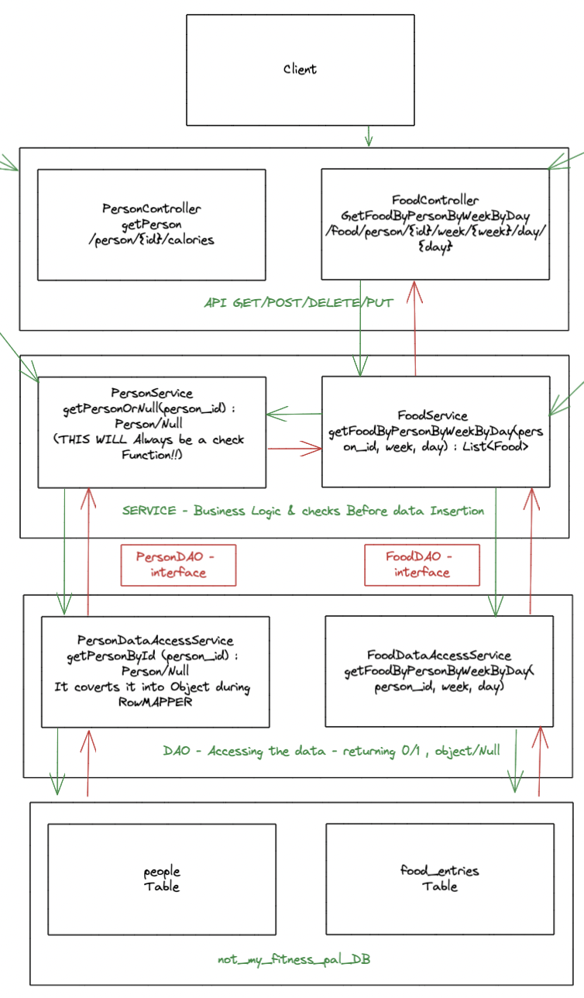
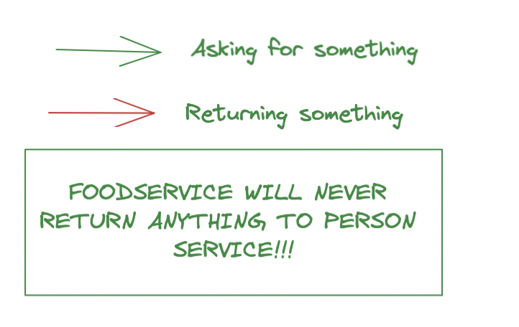
Planning - Application Structure
Sunday
Food and Person
Controller, Service, DAOs
Connection via service classes
Notes:
Nasir

Slide 6
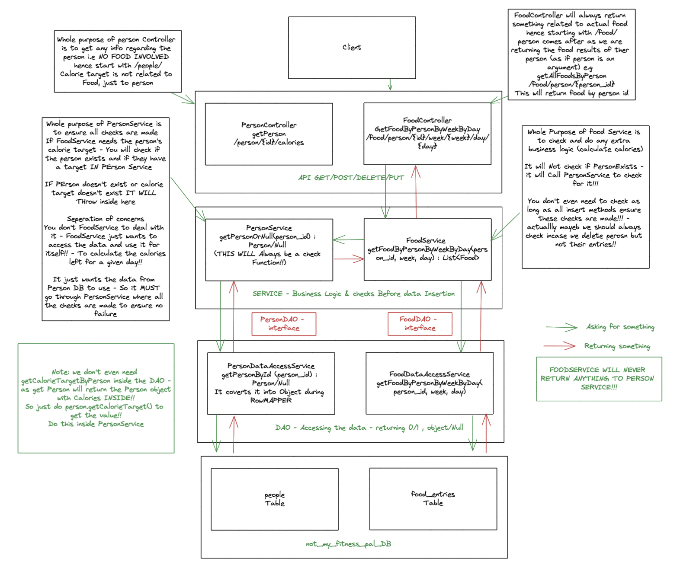
Notes:
Nasir

Slide 7
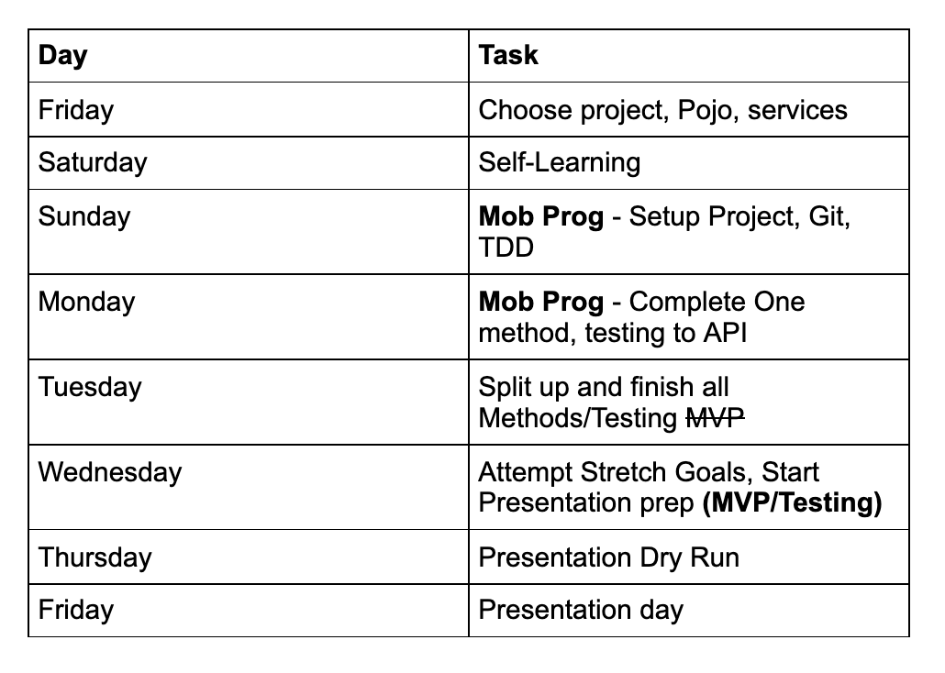
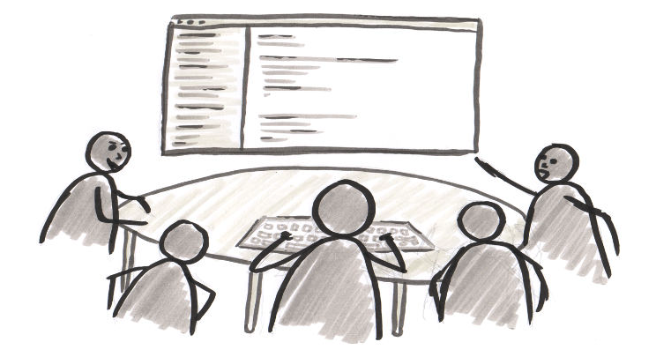
Planning - Week
Mob Programming
Everyone clued up
One method - reference
Split up on Tues/Wed
Key factor of success - collab
Notes:
Nasir

Slide 8
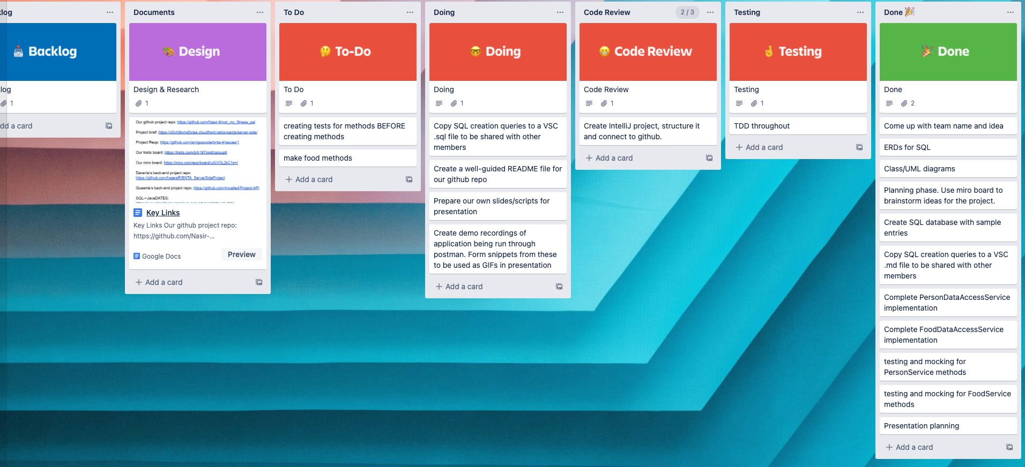
Collaboration Tools - Trello
Switch up the visual tool styles - detail/brainstorming vs broken down targets.
Cater for different minds.
Each day resembled an agile sprint (stand-up, implement, review, retrospect) - though not firmly set this way.
Notes:
Aaron

Slide 9
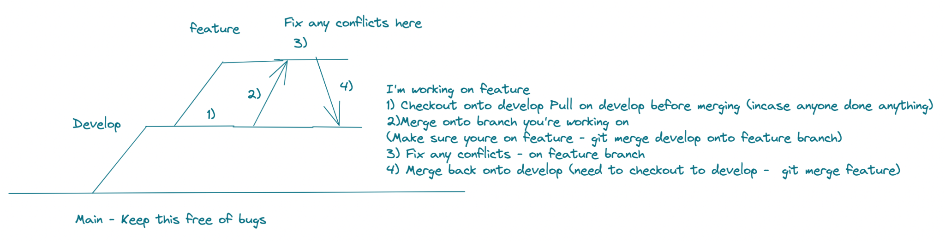
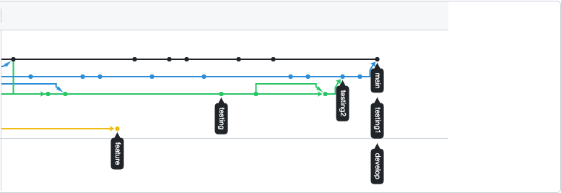
Collaboration Tools - Git
Additional branches to distinguish the type of task we were doing and avoid breaking main code.
Staggered approach to working through merges - resolving any conflicts was smoother.
Led to much more efficient merges, coping as the code base grew.
Low number of merge conflicts experienced during our project was a testament to this.
Top-right photo: A rough merge process we drew up - to reference back to when splitting off for pair programming.
Bottom-right photo: Branch structure as per github (towards end of project).
Notes:
Aaron

Slide 10
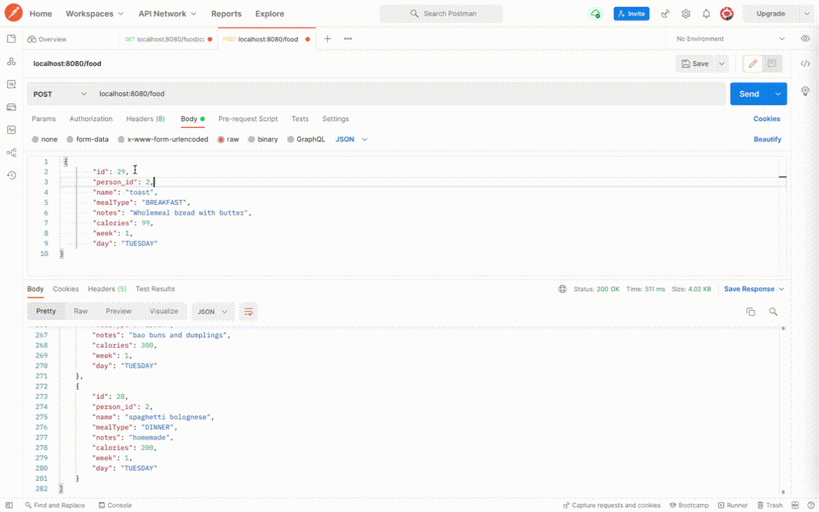
Demo: Post/Get
Notes:
Marcy

Slide 11
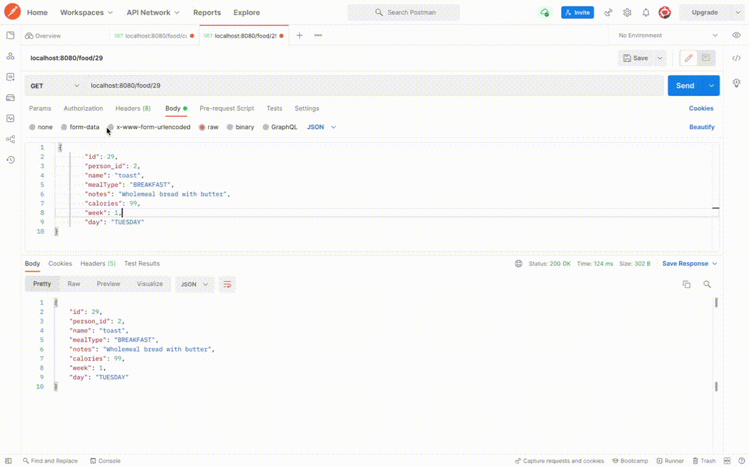
Demo: Put/Delete
Notes:
Marcy

Slide 12
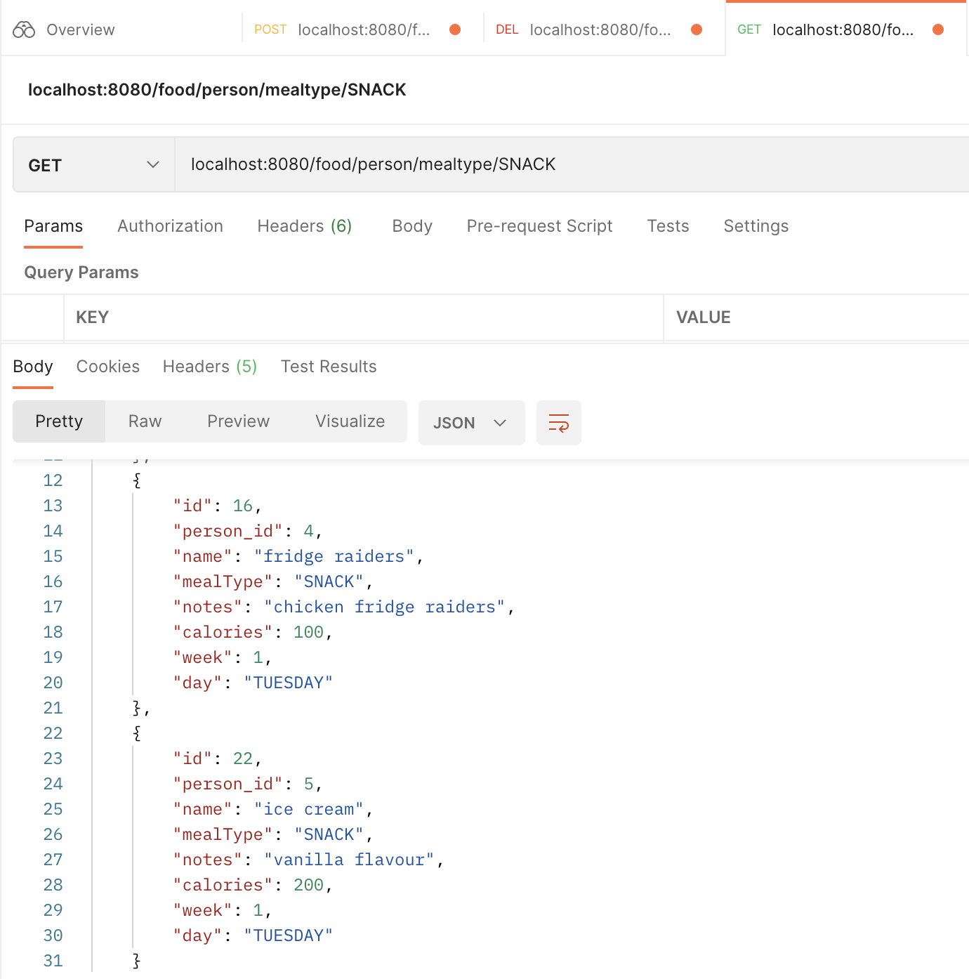
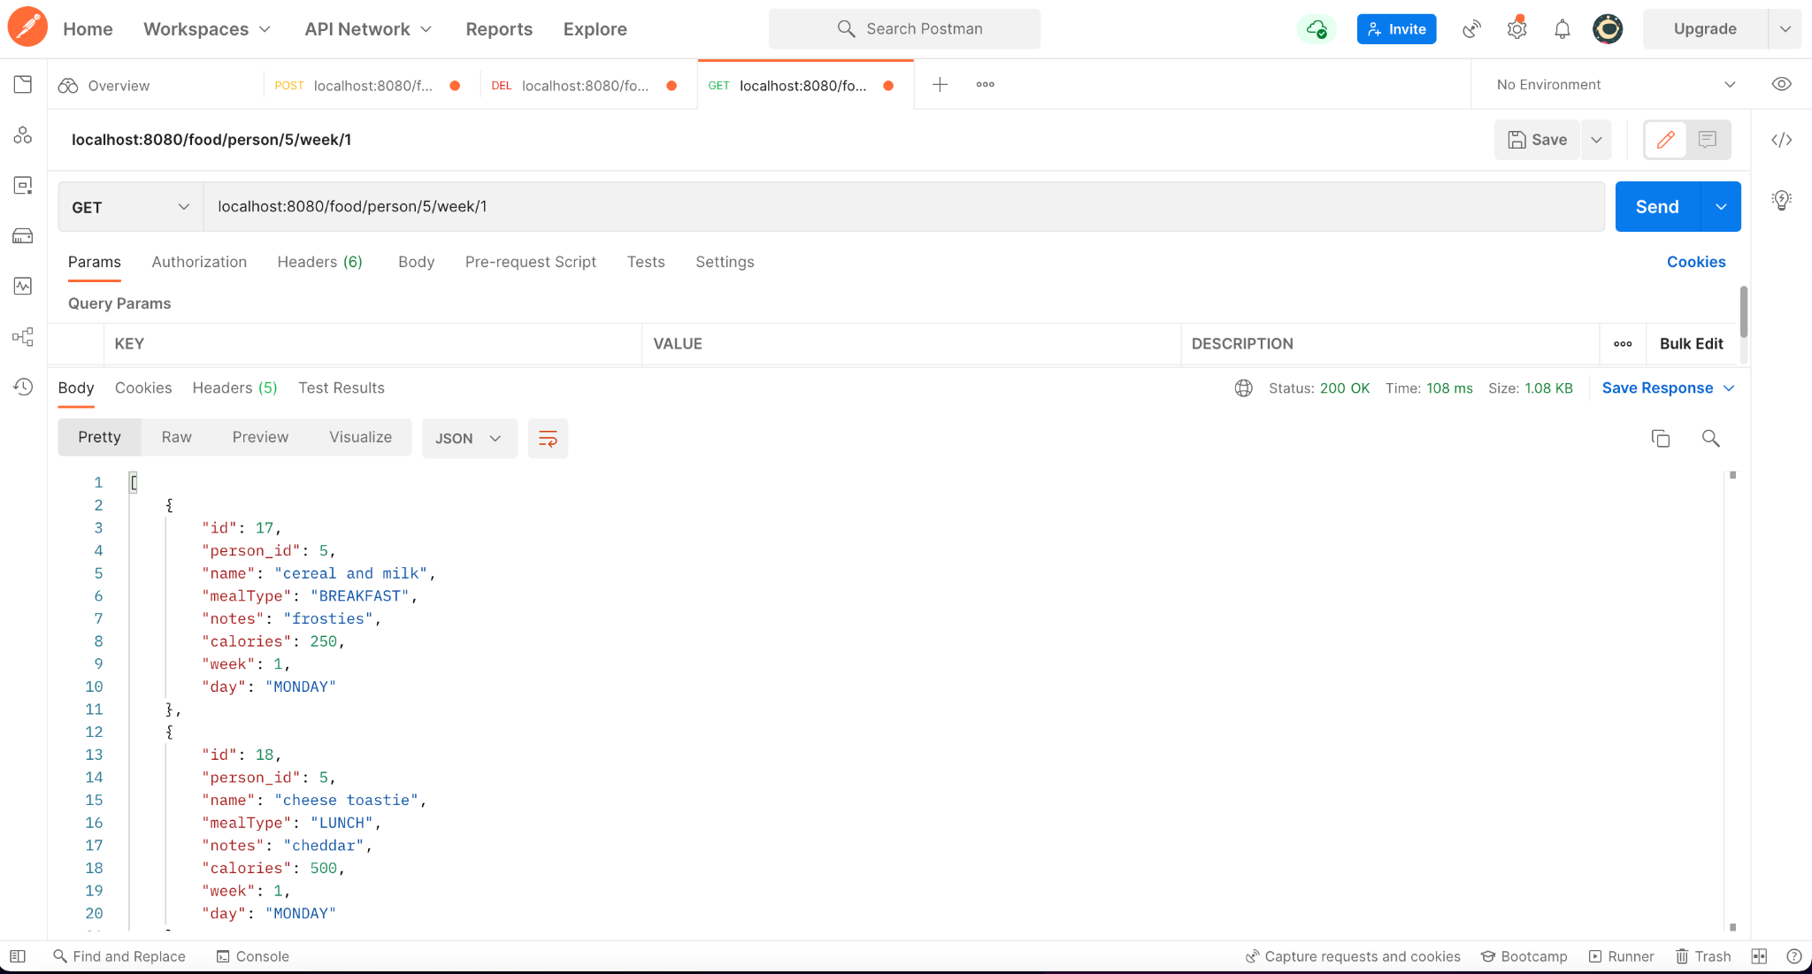
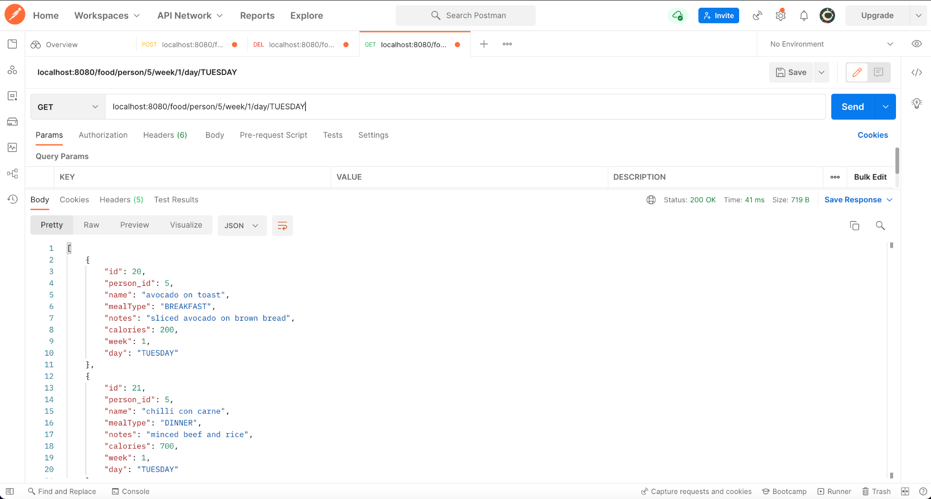
Many more
By Meal Type
By Week
By Week and Day
Notes:
Marcy

Slide 13
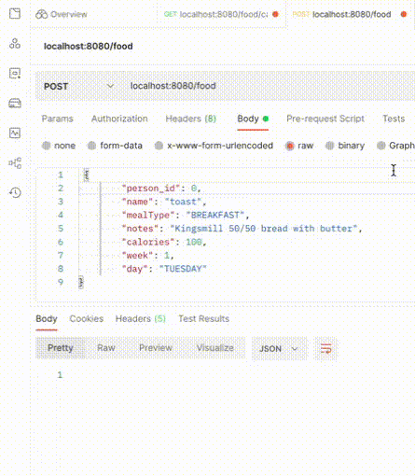
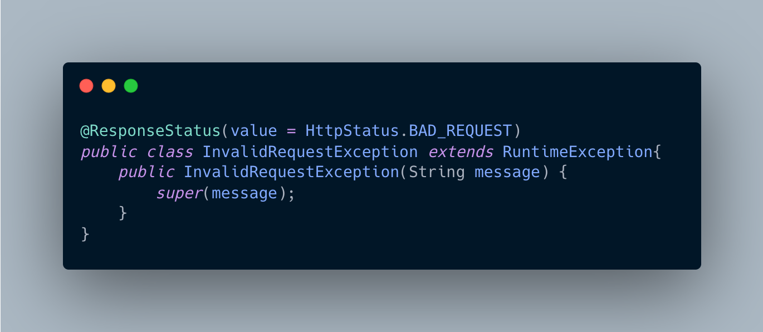
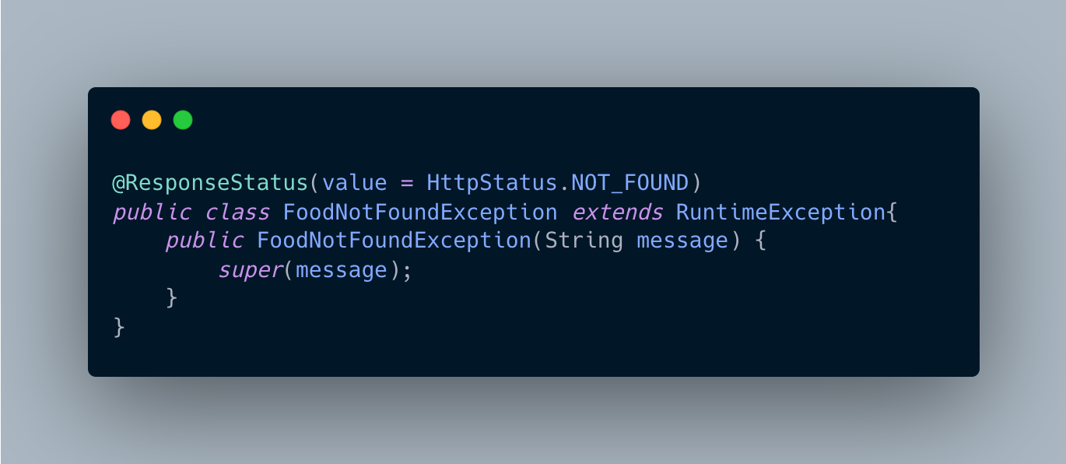
Client Errors
400 Bad Request
404 Not Found
Notes:
Marcy

Slide 14
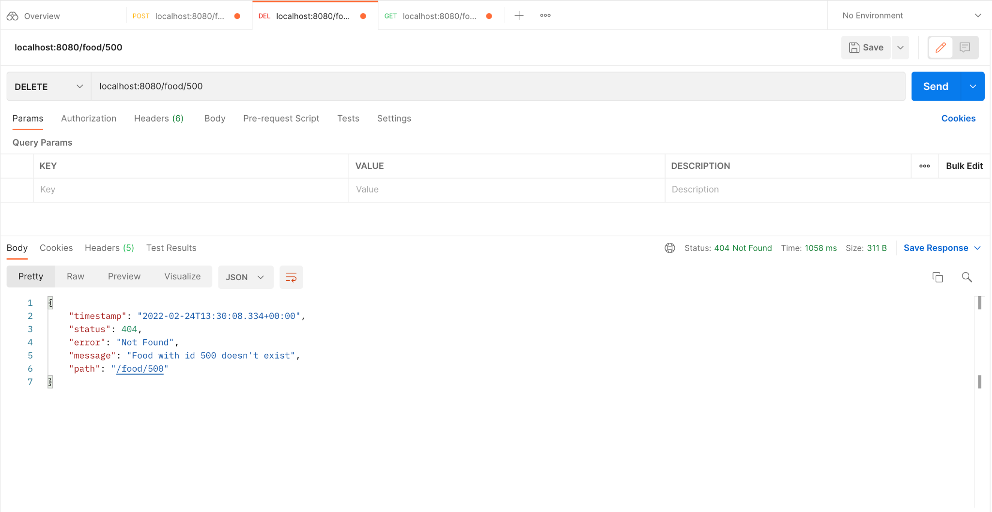
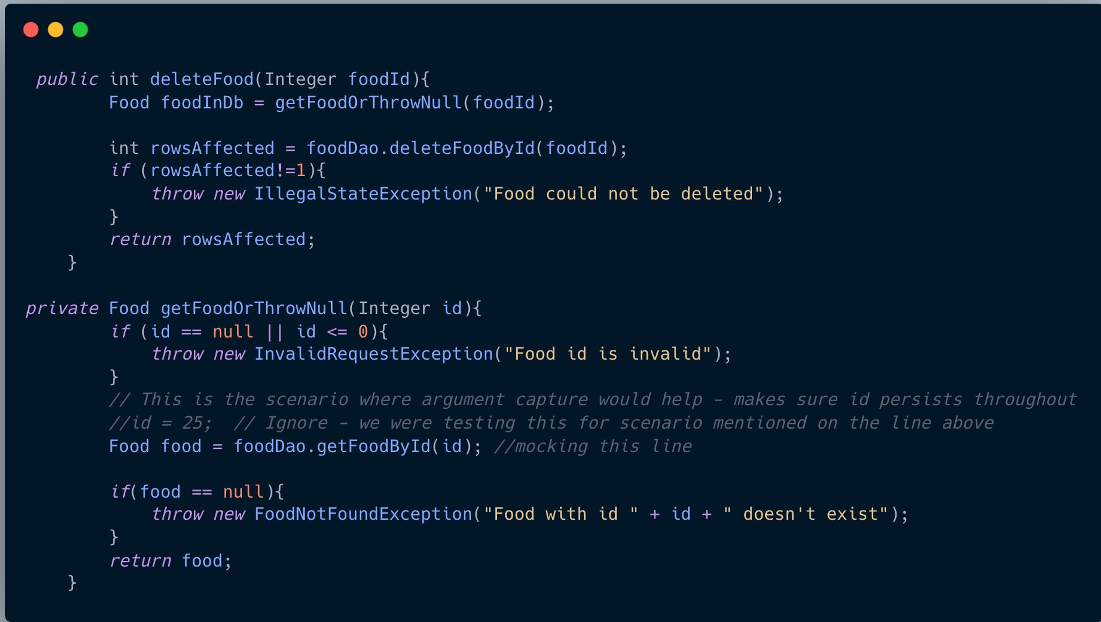
Custom Exception Class
Notes:
Marcy

Slide 15
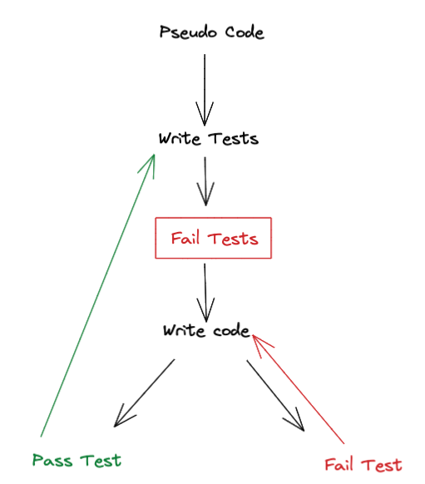
Our Approach to Testing
Lacking confidence in testing
Using TDD - a great opportunity to explore industry standard development
Approaching TDD
Mob pseudo code
Write tests
Write code
Notes:
Sarina

Slide 16
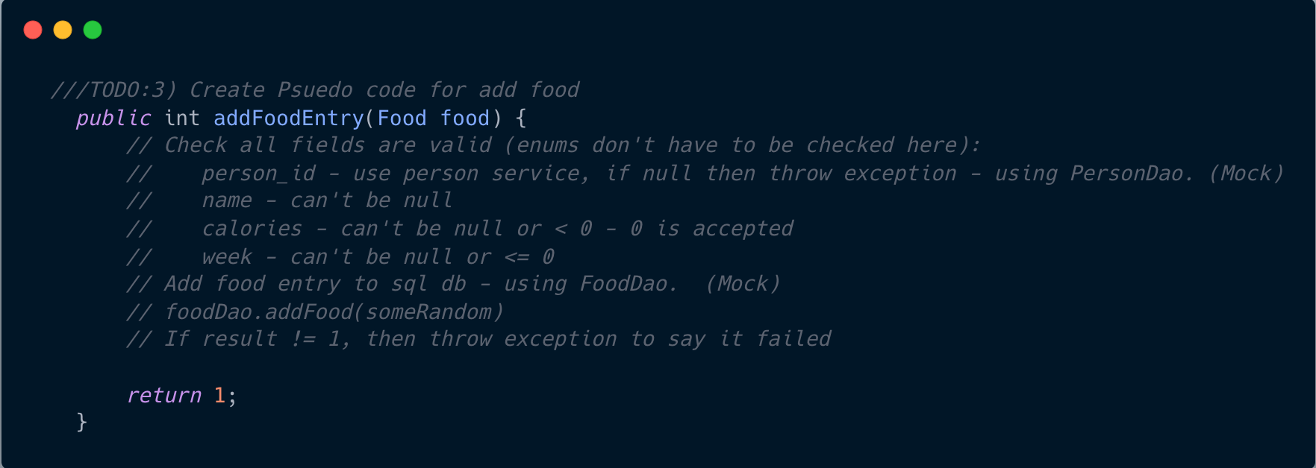
TDD in addFoodEntry method
Input
Output
Notes:
Sarina

Slide 17
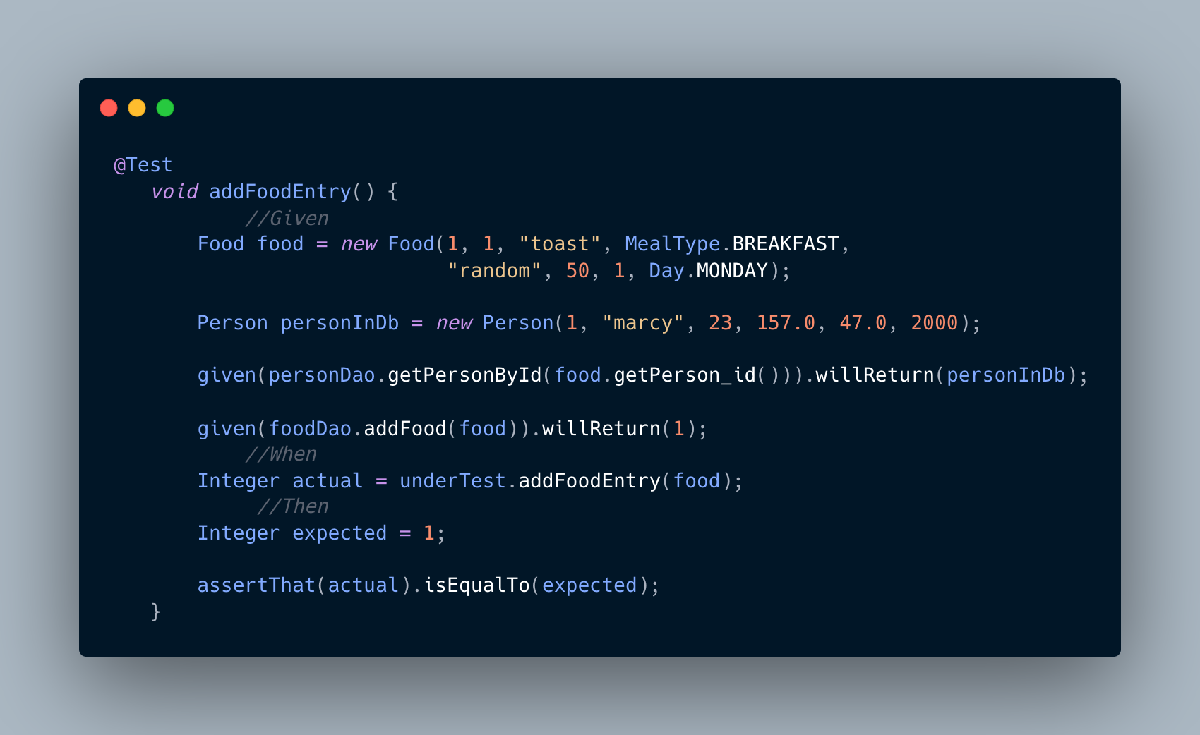
Notes:
Sarina

Slide 18
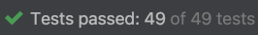
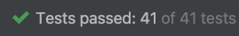
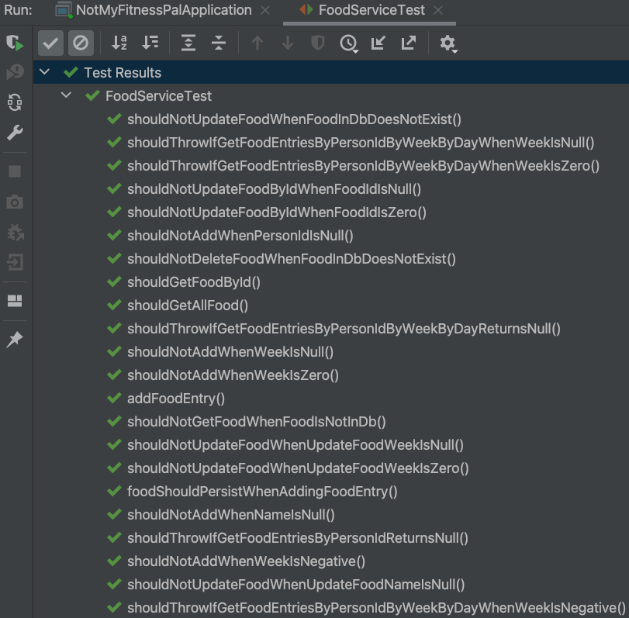
Results of TDD
Sunday/Monday - TDD focused
Tuesday/Wednesday - More ambitious with methods, less TDD
Testing took longer, less conscious business logic
90 Tests written and passed - a reliable API!
Pedagogically valuable, whole team more confident in testing
Notes:
Sarina

Slide 19
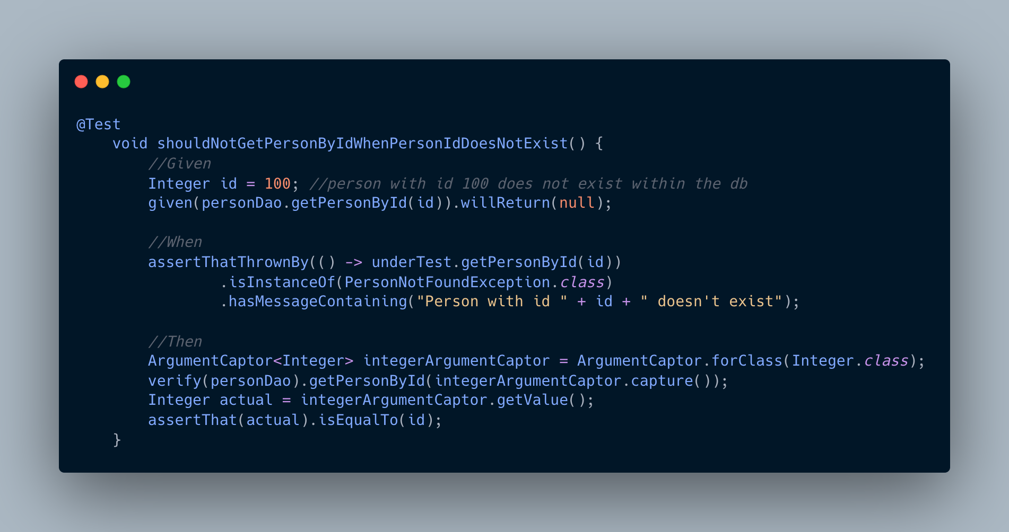
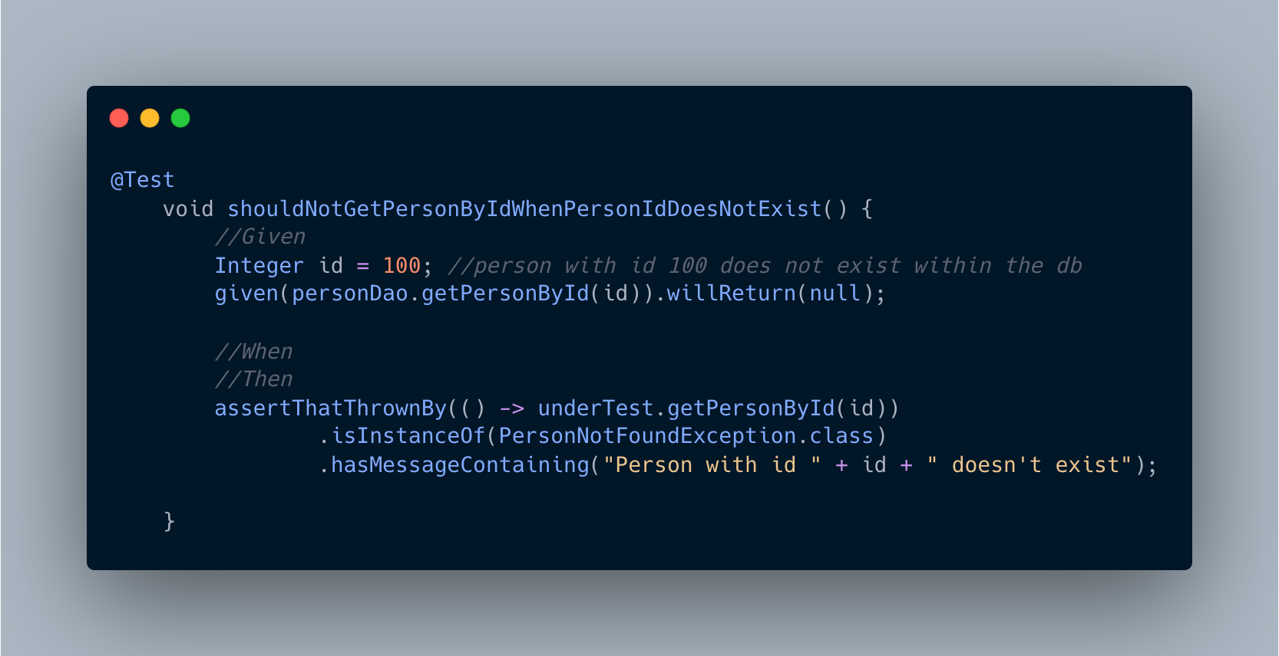

Argument Captors - a fun discovery!
BEFORE
Originally had conflict over the need for an ArgumentCaptor when comparing two tests.
Discovered the difference between them was down to primitives remaining consistent vs objects being traced as rows returned in SQL - thus not the specific object.
Cleaner code!
AFTER
Notes:
Aaron

Slide 20
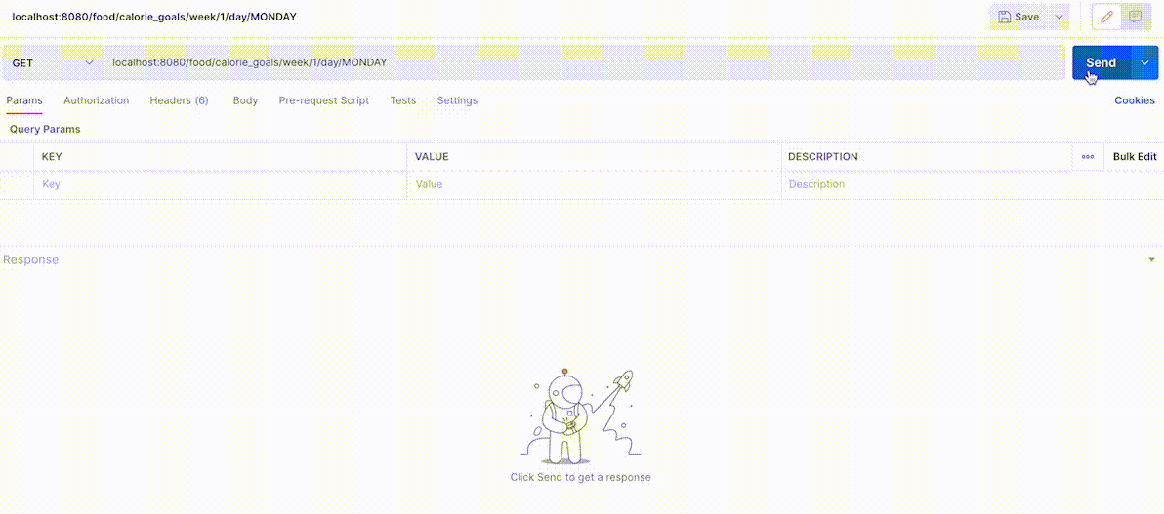
Extension - daily calorie goals
Notes:
Suraaj

Slide 21
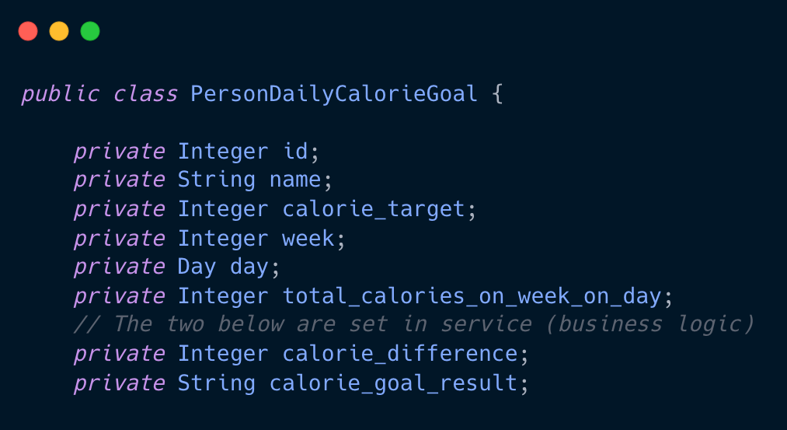
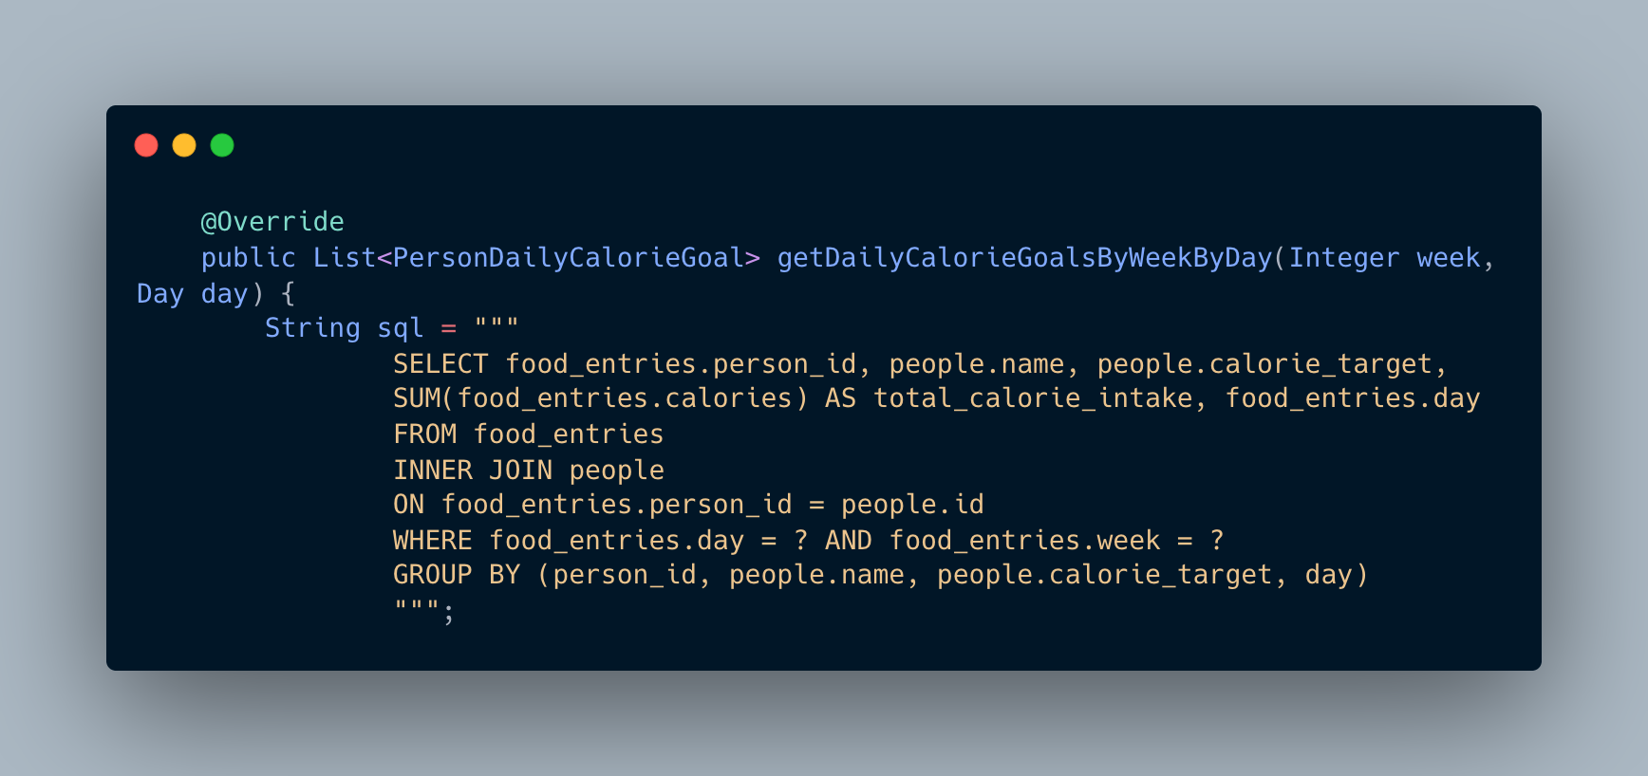
SQL implementation
Both set in service class
Calculates the sum of the total calories for a day per person
JOIN required as the food_entries table does not have access to the daily calorie target property in the people table
Notes:
Suraaj

Slide 22
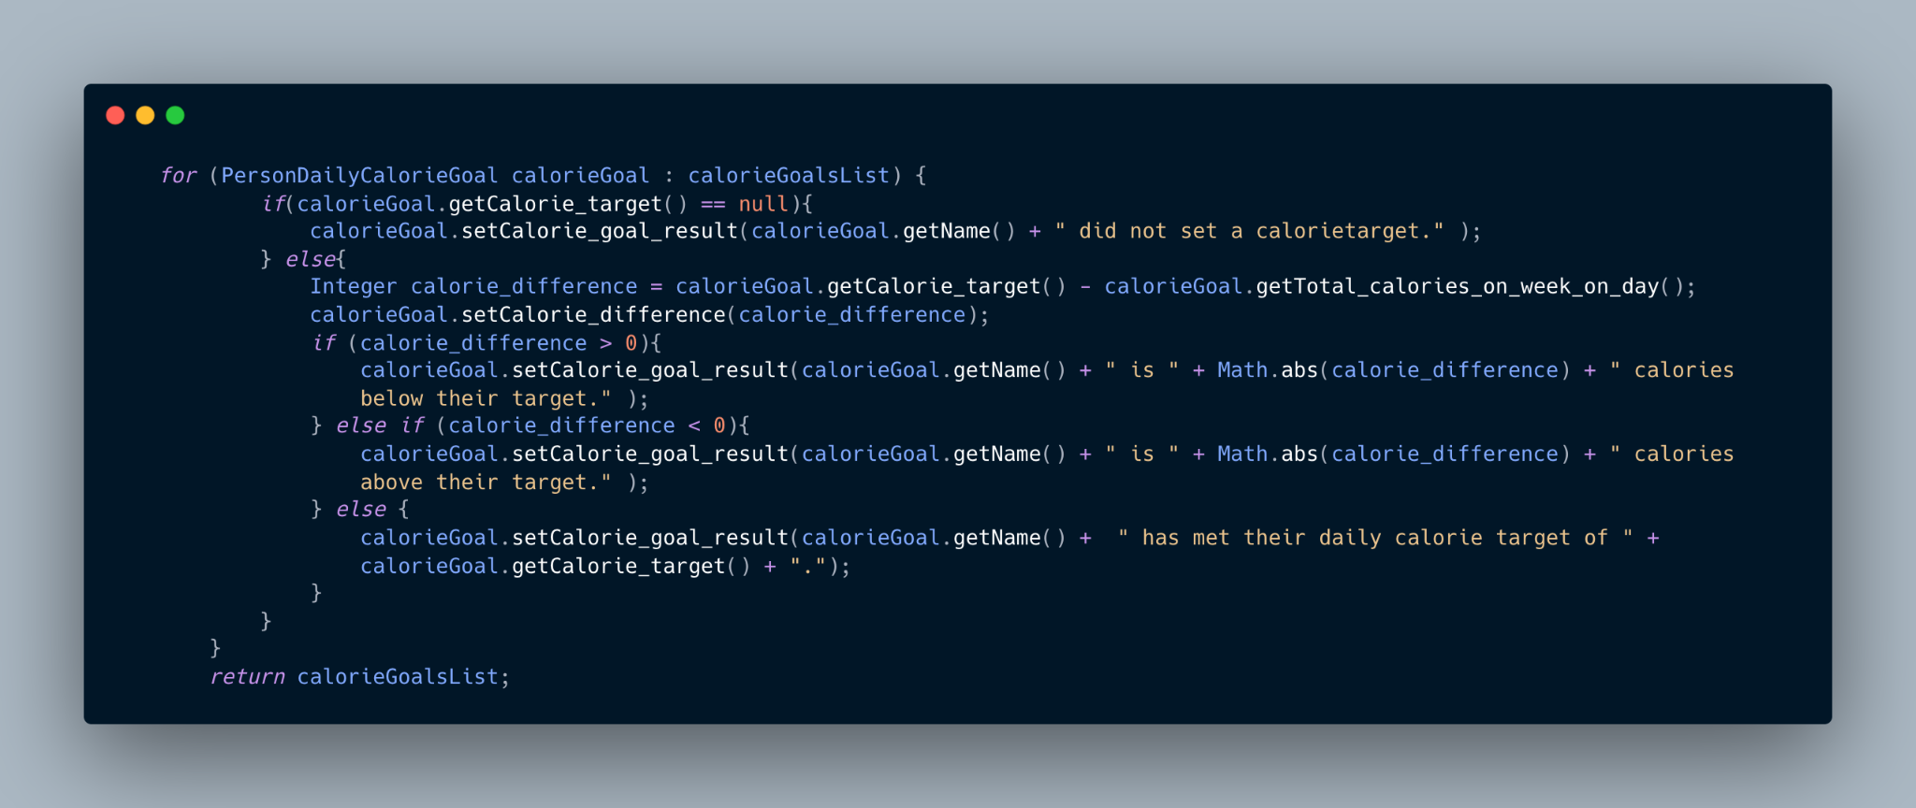
Business logic
Work out the calorie difference then SET that value for each person
SET the result property as a message indicating how much they are above/below their target
Notes:
Suraaj

Slide 23

Ideas for the future
Expand to include exercise data - include people’s daily workouts and how many calories they are burning.
Work out people’s daily net calories then compare to daily calorie target.
Notes:
Suraaj

Slide 24
Reflections
Greater understanding of project work, thorough planning and TDD
Came across interesting challenges
How to properly do TDD
ArgumentCaptor
Calorie Counting method
Please check out our repo if you’re interested! Any improvements are welcomed! https://github.com/Nasir-6/not_my_fitness_pal
Notes:
Sarina

